Slide 1
BIOINFORMATICS
The UNIX environment
Federico M. Giorgi, PhD
Department of Pharmacy and Biotechnology

Slide 2


Slide 3
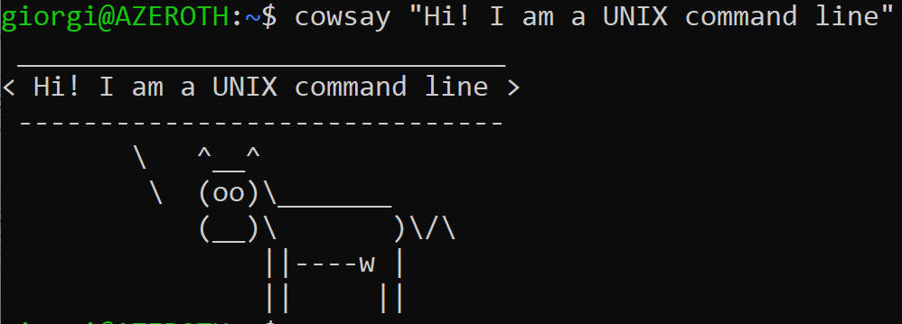
What is UNIX
It’s an OPERATING SYSTEM
Like Windows
It can be used as Windows, but it doesn’t have Microsoft Office
It has a GUI (graphical user interface) and you can use a mouse, but is heavily focused on the command line
In the command line, you type commands and get results, like in the movies

Slide 4

Unix
Why is Unix important for Bioinformatics?
Work on huge (>1GB) files
peek at them (head, tail, less, wc)
modify them (sed, vim)
mangle them (sort, cut)
Build simple and complex pipelines ( | )
Repeat custom analysis with one click
Most everyday bioinfo programs run only on Unix (samtools, hisat2, blast)
Free

Slide 5


Some History on Unix
Invented in 1969 by the Bell Labs research center
It comes from “Unics”
Uniplexed Information and Computing Service
Unix invented
Multi-tasking
Multi-Users
Hierarchical file system (directories)
Multi-platform
Linux is Unix
Linux is a modified highly successful Unix developed by Linus Torvalds
Several Unix distributions:

Slide 6




Some History on Unix
Invented in 1969 by the Bell Labs research center
It comes from “Unics”
Uniplexed Information and Computing Service
Unix invented
Multi-tasking
Multi-Users
Hierarchical file system (directories)
Multi-platform
Linux is Unix
Linux is a modified highly successful Unix developed by Linus Torvalds
Several Unix distributions:

Slide 7





Some History on Unix
Invented in 1969 by the Bell Labs research center
It comes from “Unics”
Uniplexed Information and Computing Service
Unix invented
Multi-tasking
Multi-Users
Hierarchical file system (directories)
Multi-platform
Linux is Unix
Linux is a modified highly successful Unix developed by Linus Torvalds
Several Unix distributions:

Slide 8






Some History on Unix
Invented in 1969 by the Bell Labs research center
It comes from “Unics”
Uniplexed Information and Computing Service
Unix invented
Multi-tasking
Multi-Users
Hierarchical file system (directories)
Multi-platform
Linux is Unix
Linux is a modified highly successful Unix developed by Linus Torvalds
Several Unix distributions:

Slide 9
Let’s try Unix
Some ways to run Unix:
Install it on your PC or server (hardcore)
Install it on your PC alongside Windows (dual-boot)
Online emulators https://geekflare.com/run-linux-from-a-web-browser/
Mac-OS X is a Unix-like system, most commands will work in its terminal
Install it inside Windows (Windows Subsystem for Linux introduced it in 2018)
Virtualization (VMWare, VirtualBox)

Slide 10


The Virtualization Way
Very popular but it requires a powerful PC to run two OSs at the same time
Your Operating System
Virtualization System (e.g. VMware, VirtualBox)
UNIX system (e.g. CentOS, Xubuntu)

Slide 11
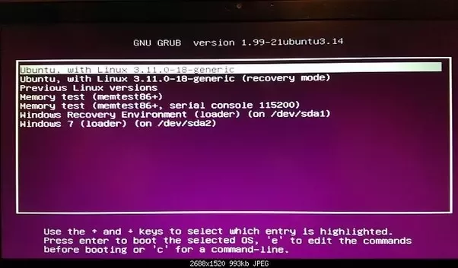
Best solution: The Bioinformatics Lab Way
On your lab computers, when the system is booted, you can pick the system
Once you are on Ubuntu, open the Terminal
Windows key + type in "terminal", then press ENTER

Slide 12

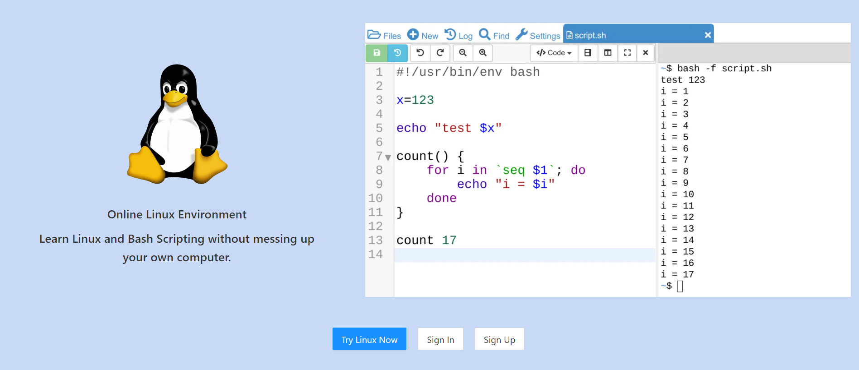
The Online Way
Best way to start teaching Unix
COCALC offers also online emulators for Python, Octave, etc.
The current version of COCALC offers online Ubuntu emulator
This Ubuntu is designed for Bioinformatics: it means that I asked them to install some useful programs for you! ;-)
Go to https://cocalc.com/features/linux

Slide 13
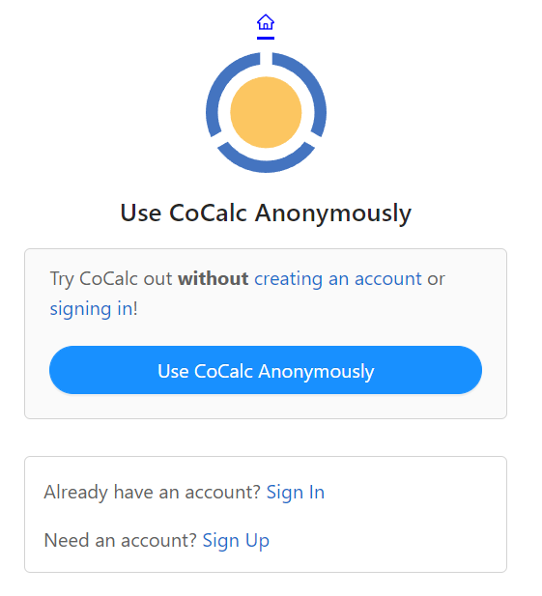
The COCALC Way
https://cocalc.com/features/linux

Slide 14
On the first run you will be asked to pick:
https://cocalc.com/features/linux
1
2
You can choose either!
You can safely use it anonymously for all these lessons

Slide 15
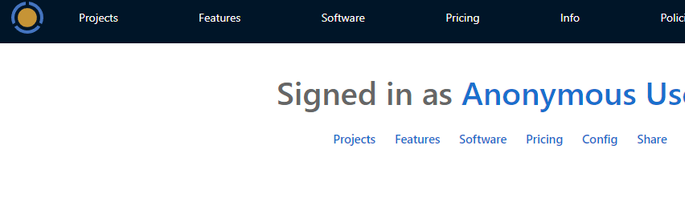
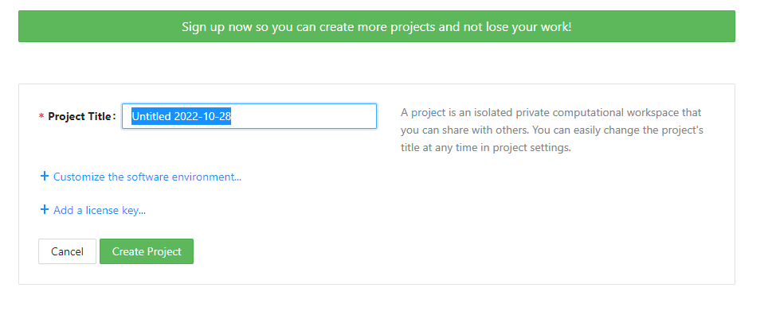
Create a Project
Click on Project
Create Project
(any title is fine)

Slide 16
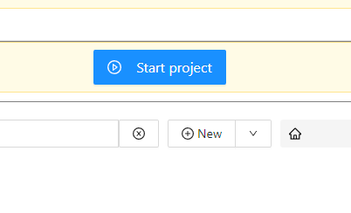
Start Project

Slide 17

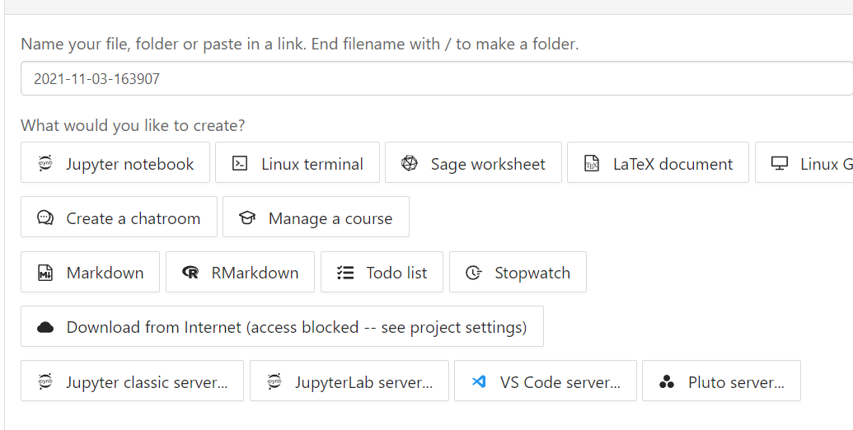
Create a Linux terminal
Click on "New" (top left)
No seriously, click on it. This will appear:

Slide 18
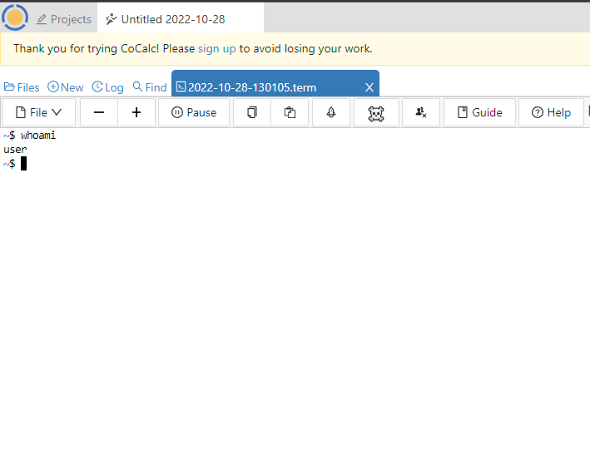
This is your Linux terminal!
Synonyms: terminal, shell, bash, environment, command line
https://cocalc.com/doc/linux.html

Slide 19
1. UNIX Basics

Slide 20

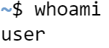
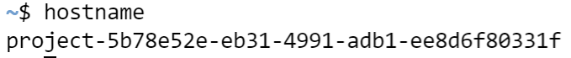
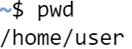
Let’s start by typing in some simple commands
Commands must be typed into the shell and executed by pressing ENTER
User name
whoami
Name of the system
hostname
Present working directory
pwd

Slide 21
Your Unix File System
/
“root”
bin
sbin
etc
tmp
lib
usr
home
Directory | Typical Contents
/ | The "root" directory
/bin | Essential system programs
/sbin | Superuser system utilities (for performing system administration tasks)
/etc | UNIX system configuration and information files
/tmp | Temporary file storage space (can be used by any user)
/lib | Program libraries (collections of system calls that can be included in programs by a compiler) for low-level system utilities
/usr | Higher level user programs
/home | User home directories containing personal file space for each user. Each directory is named after the login of the user.
/dev | Hardware devices
/media | Removable hardware devices
/proc | A pseudo-filesystem for each active program
/var | For various other things
/var/log | For system logs

Slide 22
Your Unix File System
/
“root”
bin
sbin
etc
tmp
lib
usr
home
~
“tilde”, an alias for your home
user
Directory | Typical Contents
/ | The "root" directory
/bin | Essential system programs
/sbin | Superuser system utilities (for performing system administration tasks)
/etc | UNIX system configuration and information files
/tmp | Temporary file storage space (can be used by any user)
/lib | Program libraries (collections of system calls that can be included in programs by a compiler) for low-level system utilities
/usr | Higher level user programs
/home | User home directories containing personal file space for each user. Each directory is named after the login of the user.
/dev | Hardware devices
/media | Removable hardware devices
/proc | A pseudo-filesystem for each active program
/var | For various other things
/var/log | For system logs

Slide 23
Your Unix File System
/
“root”
bin
sbin
etc
tmp
lib
usr
home
user
Directory | Typical Contents
/ | The "root" directory
/bin | Essential system programs
/sbin | Superuser system utilities (for performing system administration tasks)
/etc | UNIX system configuration and information files
/tmp | Temporary file storage space (can be used by any user)
/lib | Program libraries (collections of system calls that can be included in programs by a compiler) for low-level system utilities
/usr | Higher level user programs
/home | User home directories containing personal file space for each user. Each directory is named after the login of the user.
/dev | Hardware devices
/media | Removable hardware devices
/proc | A pseudo-filesystem for each active program
/var | For various other things
/var/log | For system logs
any
other
sub
dir
Programs
Desktop
you
may
imagine
seqs
presentations

Slide 24
“In the beginning was the Command Line”
We are all used to graphical user interfaces (GUI), which can dramatically simplify computer use
In many contexts the most powerful and flexible way to interact with a computer is through a command-line interface (CLI)
In such an interface, the user types commands that tell the computer to perform desired tasks
These commands can then be combined in various ways to achieve a variety of outcomes

Slide 25
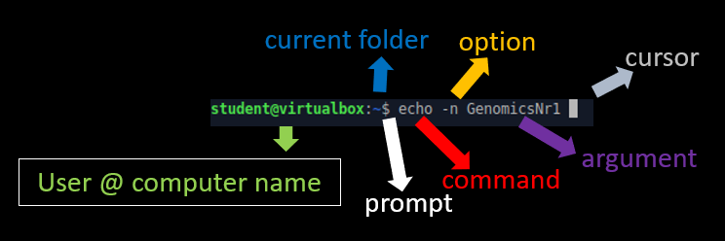

Running a terminal
To run a command-line command, we will use a terminal, which is the program that gives us a command line
Every command line starts with some symbol or symbols designed to “prompt” you to action. The prompt usually ends with a dollar sign $
$ is preceded sometimes by information that depends on the details of your system. For example, on some terminals it might look like this:
In COCALC it will instead look like this, because they omit showing you the user and computer names:

Slide 26
Our first command
echo prints words on screen
$ echo Bioinformatics
Bioinformatics
$
(I recommend always typing the commands out yourself, which will let you learn more than if you rely on copying and pasting).
In all commands it is good practice to separate command from arguments using quotes:
$ echo 'Bioinformatics Rules'
Bioinformatics Rules
$ echo "Bioinformatics Rules"
Bioinformatics Rules
$

Slide 27

Getting stuck
One thing that can happen when using quotes is accidentally not matching them, as follows:
$ echo "Bioinformatics Rules
>
At this point, it seems we’re stuck! Like Winnie the Pooh up there. There are specific ways out of this quandary (in fact, in this case you can just add a closing quote and hit return), but it’s good to have a general strategy for getting out of trouble.
This strategy is called “Ctrl-C”.

Slide 28
Getting out of trouble with Ctrl-C
When using the command line, there are lots of things that can get you “in trouble”
The terminal will just hang or otherwise end up in a state that makes entering further commands difficult or impossible
Here are some examples of such commands:
$ echo "Bioinformatics
$ grep foobar
$ yes
$ tail
$ cat
In every case, the solution is Ctrl-C (while holding CTRL, press c)
UNIX will show that you pressed it with the symbol ^C
In some terminals, ESC works instead of Ctrl-C
$ cat
^C

Slide 29
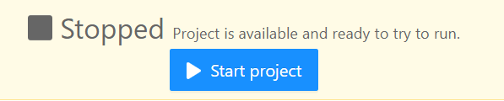
Exercises
If the session stops, just click on Start project
Write the classic command that prints out the string “Hello, world!”
do it two different ways, both with and without using quotation marks, and with single and double quotation marks
Type the command echo 'Hello (with a mismatched single quote), and then get out of trouble using the technique we just saw

Slide 30
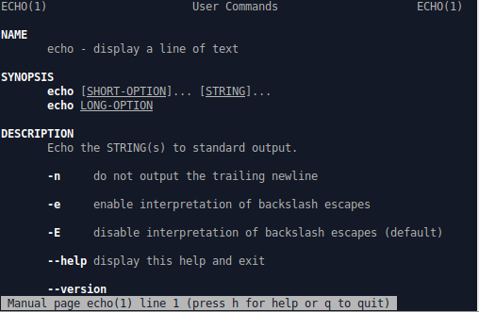
Man pages
Try to read the manual of our first command
$ man echo
On the last line of this output, the grey line indicates that there is more information below.
Press the down arrow key, or one page at a time by pressing the spacebar, or even use the mouse wheel.
To exit the man page, press “q” (for “quit”).

Slide 31
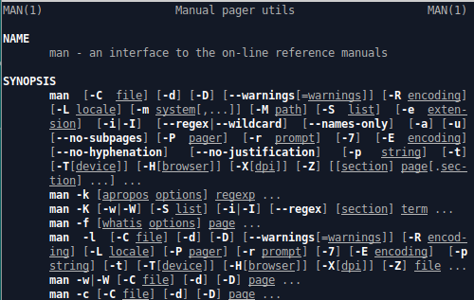
Man pages
Because man itself is a command, we can apply man to man
$ man man
The output of man is sometimes very esoteric, like this one
Nevertheless, being able to scan over the man page to get a high-level overview of a command is a valuable skill, one worth acquiring
I recommend always running man <command name> when encountering a new command
Even if the details aren’t entirely clear, reading the man pages will help develop the valuable skill of technical sophistication and problem solving

Slide 32


Debugging in Bioinformatics
Read man pages
RTFM: Read the F manual
Press CTRL-C and try again
Have you rebooted the device?
Have you tried uninstalling and reinstalling the app?

Slide 33
Exercises
By default, the echo command prints its argument to the screen and then puts the new prompt on a new line. The way it does this is by appending a special character called a newline (a special character that literally puts the string on a new line, written in many contexts as “backslash n” \n). Because echo is often used in programs to print out a sequence of strings not separated by newlines, there is a special command-line option to prevent the newline from being inserted
By reading the man page for echo, determine the command needed to print out “Genomics” without the trailing newline, and verify using your terminal that it works as expected
Try to print multiple empty lines by merging words and newline special backslash characters \n. (Hint: you should enable a specific option for it to work)

Slide 34

Editing the line
Command lines include several features to make it easy to repeat previous commands, possibly in edited form
These and many other command-line features often involve special keys on the keyboard, so for reference the following Table shows these symbols for the various keys:
One of the most useful ways to edit the line is to “up arrow” ↑, which simply retrieves the previous command. Pressing up arrow again moves further up the list of commands, while “down arrow” ↓ goes back toward the bottom
Key | Symbol
Control | ⌃
Shift | ⇧
Option | ⌥
Up, down, left, right | ↑ ↓ ← →
Enter/Return | ↵
Tab | ⇥
Delete

Slide 35
Editing the line (2)
Other common ways to edit the line use the control key (CTRL)
For example, when typing a new command, or dealing with a previous command, it is often convenient to be able to move quickly within the line.
Suppose we entered (to paste inside the terminal, copy here and paste with SHIFT+CTRL+V):
$ "I love genomics in the afternoon"
bash: I love genomics in the afternoon: command not found
We forgot to put echo in front of it. No problem!
Press arrow up ↑ to retrieve it
You can press ← to go to the beginning, but it's easier to type CTRL-A
CTRL-E goes to the end of the line
CTRL-U clears the beginning of the line, letting us starting over
In many UNIX systems, also HOME and END key works alongside CTRL-A and CTRL-E

Slide 36
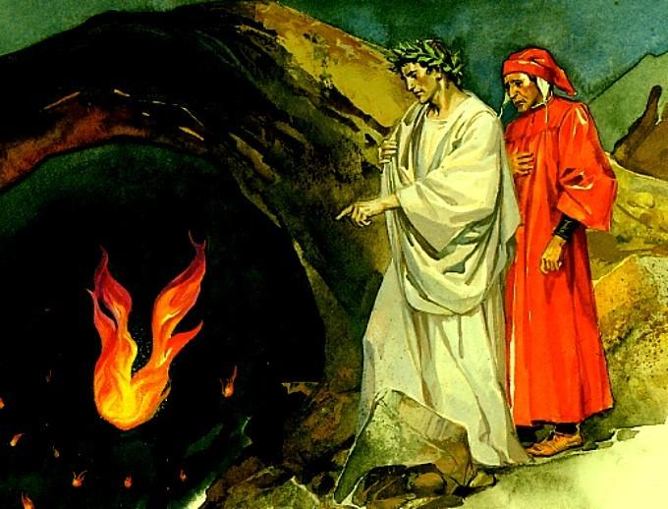
Editing the line (3)
If you are editing a long line, you may need more particular ways to move
E.g. take this command, containing a line from Inferno Canto XXVI by Dante:
$ echo 'Lo maggior coRno de la fiamma antica'
Suppose we wanted to change "coRno" to "corno" to prevent Dante from turning in his grave
We could use CTRL-A, or ←
Or we could move word by word, using CTRL-→ and CTRL-←
When typing very long commands (e.g. to align reads on a genome, CTRL-A, CTRL-E, CTRL-→ become very useful

Slide 37
Commands Recap of Section 1 (UNIX Basics)
Here's a summary of what you have learned
Command | Description | Example
echo <string> | Print string to screen | $ echo hello
man <command> | Display manual page for command | $ man echo
CTRL-C | Get out of trouble | $ tail CTRL-C
CTRL-A | Move to beginning of line
CTRL-E | Move to end of line
CTRL-U | Delete to beginning of line
Up & down arrow | Scroll through previous commands
clear or CTRL-L | Clear screen | $ clear
exit or CTRL-D | Exit terminal | $ exit

Slide 38
Exercises
Using the up arrow, print to the screen the strings “fee”, “fie”, “foe”, and “fum” without retyping echo each time.
Copy/paste this sentence in the terminal and correct the capitalization and the extra * characters using the commands you just learned to move around the line. Then echo the sentence. PS you don’t need to know Italian for this: in the future we will do the same with DNA sequences, that are even more cryptic.
"faTti on fostE a*** viver com***e bruti ma per se**guir virtute e cAnoscenzA"
Remember: you can paste in the terminal using Shift-Ctrl-V

Slide 39
Exercises (continued)
Write a command to print the string, including the quotes:
My favourite topic: "Genomics"
i.e., take care not to print out My favourite topic: Genomics
There are several ways to do this. Hint: remember you can use both single and double quotes. And remember about the magic \ backslash character from before.
By running man sleep, figure out how to make the terminal “sleep” for 5 seconds, and execute the command to do so
Execute the command to sleep for 50 minutes. Cancel the command following the “get out of trouble” strategy

Slide 40
Cleaning up
You should have written a lot of stuff on the terminal by now
To keep things clean, we can use this command:
$ clear
This "clear" can be achieved also by typing CTRL-L
Also, when you are done working with a terminal, we should exit using this command:
$ exit
An "exit" can also be achieved with CTRL-D
If you are using an online emulator, exit won't work, you can just close the page

Slide 41
2. Manipulating files

Slide 42
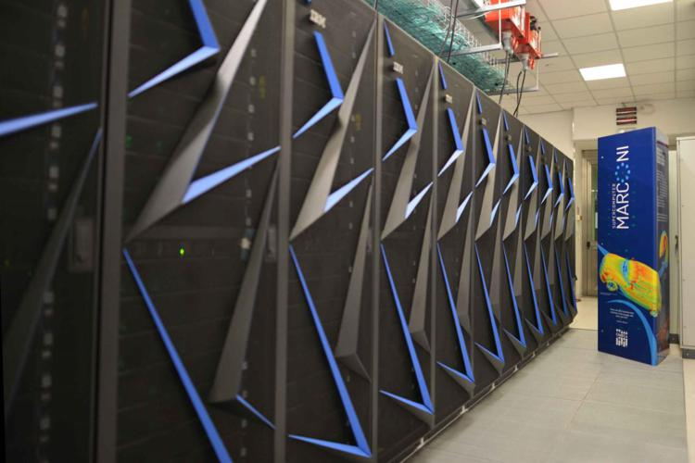
Why using the command line to manipulate files?
You can work on huge files without loading all of them
Commands can be written and repeated on new files without clicking the mouse
Commands can be pasted together in long pipelines
You can work remotely on command-line only servers: beasts that can be tamed only by LINUX knowledge, e.g., the CINECA cluster:

Slide 43
Standard way to download any file from the internet
E.g. from ENSEMBL http://www.ensembl.org/Homo_sapiens/Info/Index
1) Download
wget
2) Gunzip it
gunzip
3) Visualize it
cat
Visualize files in the current directory, “list”
ls

Slide 44
Exercises
Download the file from https://www.dropbox.com/s/70xm8sp9sf9crn9/genomics.txt.gz?dl=1
Upload it on your COCALC session
On non-tutorial LINUX systems, you can just run the command
wget https://www.dropbox.com/s/70xm8sp9sf9crn9/genomics.txt.gz
or
curl –O https://www.dropbox.com/s/70xm8sp9sf9crn9/genomics.txt.gz
The file is gzipped. Gunzip it with the gunzip command
You can check if the file is downloaded before and after doing it, by typing ls
Visualize it. The command cat is great for this

Slide 45

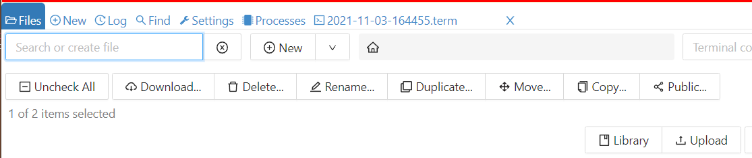
How to Upload a file to COCALC
On your COCALC tutorial environment, you must upload a file manually
First, download the file from: https://www.dropbox.com/s/70xm8sp9sf9crn9/genomics.txt.gz?dl=1
On COCALC
1. Click on Files (top left)
2. Click on Upload (top right)
1
2
Upload your file (genomics.txt.gz)

Slide 46
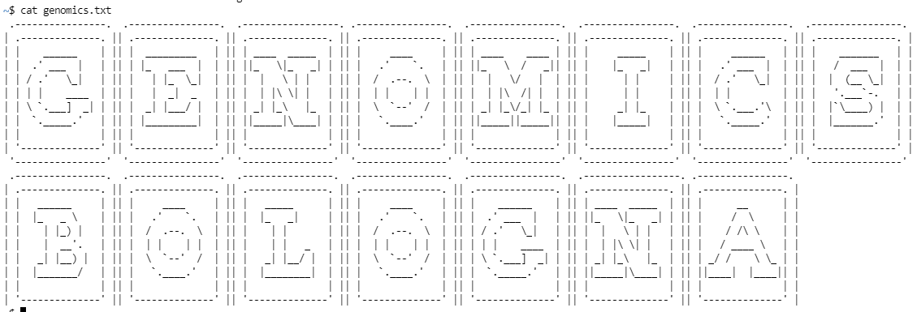
Exercises

Slide 47
Redirect output
The output of echo normally is printed on the screen
“On the screen” is CALLED the STDOUT (“standard out”) destination
The STDOUT is lost forever after you close the terminal
What if we wanted to save it, e.g. by storing it in a file?
Let’s take a "word" made of nucleotide letters
A: Adenine
C: Cytosine
G: Guanine
T: Thymine
You can type this by hand, but sometimes it's better to copy/paste, or you may introduce "mutations"
$ echo "TTGCTTTTTTTGTCTTCTTCAGACCAC"

Slide 48

Redirect output (2)
$ echo "TTGCTTTTTTTGTCTTCTTCAGACCAC" > sequence.txt
Tip: you don't need to copy/paste this, you can just retrieve the previous command by pressing the ↑ key
The > is the redirect operator and it prints the output of every LINUX command to a destination. Usually, a file
Did it work? Let's check the contents of the file with the cat command
$ cat sequence.txt
cat comes from "concatenate", and it can be used to paste together files
However, it is often used as a quick way to visualize the contents of a file

Slide 49
Appending
We can use the >> operator to append a second line to our nucleotide sonnet:
$ echo "GACATGGGACTCAGCGACGGG" >> sequence.txt
The file will look like this:
$ cat sequence.txt

Slide 50
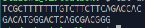
Comparing files
Let's introduce a MUTATION to our sequence
Repeat what you did before, but adding a single difference
$ echo "TCGCTTTTTTTGTCTTCTTCAGACCAC" > another.txt
$ echo "GACATGGGACTCAGCGACGGG" >> another.txt
$ cat another.txt
To compare files, LINUX gives us a useful command:
diff showing the lines that are different (useful if you have long tiles)
$ diff sequence.txt another.txt

Slide 51
The output of diff, explained
file1.txt
file2.txt
this is the original text
line2
line3
line4
happy hacking !
this is the original text
line2
line4
happy hacking !
GNU is not UNIX
$ diff file1.txt file2.txt
3d2
< line3
5a5
> GNU is not UNIX
< - denotes lines only in file1.txt
> - denotes lines only in file2.txt
3d2 and 5a5 denote line numbers affected and which actions were performed
d stands for deletion
a stands for addition
c stands for change

Slide 52
Exercises
Was the sequence we generated a DNA or RNA sequence?
Generate a file genomics.txt with the same word “Genomics” repeated three times in three different lines, using echo and > once and >> twice
Use cat to combine the contents of sequence.txt and genomics.txt using a single command, yielding the file abomination.txt. Hint: The cat command can take multiple arguments.
Check differences between abomination.txt and sequence.txt

Slide 53

Short break: the MYSTERY SEQUENCE
$ cat sequence.txt
TTGCTTTTTTTGTCTTCTTCAGACCAC
GACATGGGACTCAGCGACGGG
This is not a random sequence
We will leave the terminal for a few minutes and check the origin of this DNA string
It comes from a very special organism
Any ideas on how to find which one?

Slide 54
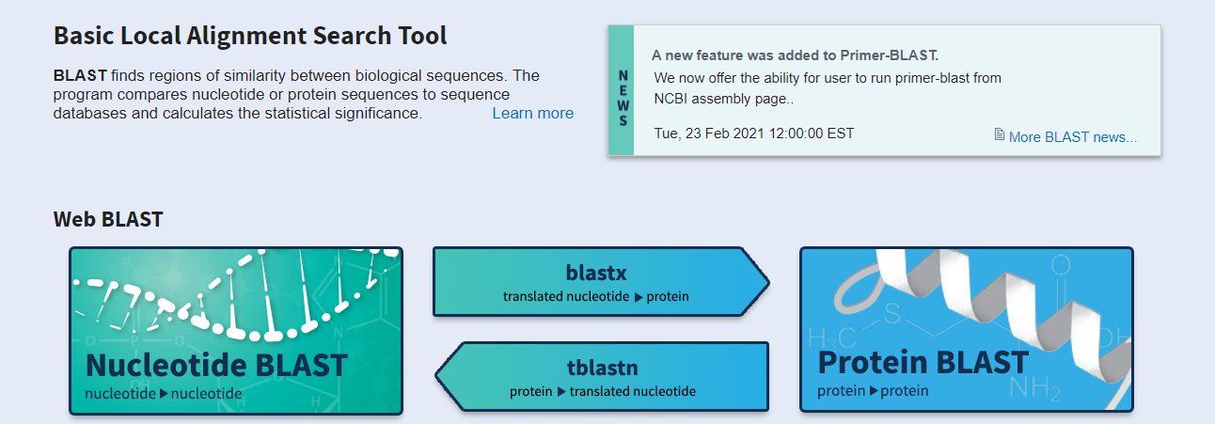
First instinct of the Bioinformatician: BLAST it!
BLAST: Basic Local Alignment Search Tool
You can find online BLAST here: https://blast.ncbi.nlm.nih.gov/Blast.cgi
Do you click on "protein blast" or "nucleotide blast"?
Copy the two lines of sequence (output of cat) and paste them in BLAST

Slide 55
Exercises
What is the purpose of this nucleotide sequence?
What is the most likely organism from which this sequence was extracted?
What are closely related species you will see from the BLAST output?
What are the differences if you paste only the first line of the sequence?

Slide 56
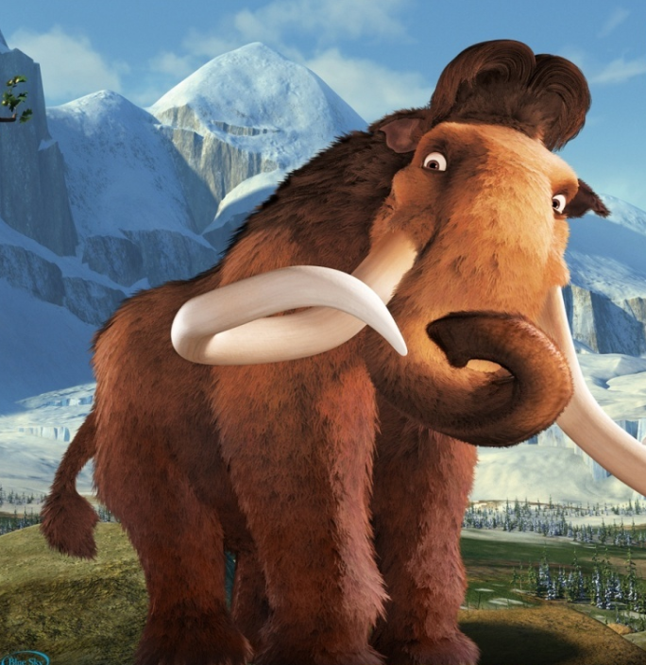
Now let's go back to LINUX!

Slide 57
Listing files
The most frequently typed command in LINUX is ls
Short for "list"
$ ls
You will see some files
You can also use ls to check if a file exists
$ ls sequence.txt
sequence.txt
$ ls foo
ls: foo: No such file or directory
$ touch foo
$ ls foo
foo
The touch command:
Changes the modification time of a file
If the file doesn't exist, it creates it

Slide 58


The wildcard character *
*, asterisk, in this case it's called "star"
$ ls *.txt
Command above ("el-es star dot tee-ex-tee") expands filenames
It basically says "any string followed by .txt"
It can be used anywhere and multiple times, e.g.:
$ touch seq1.txt seq2.txt seq1.any seqx1.any
$ ls seq*
seq1.any seq1.txt seq2.txt sequence.txt seqx1.any
$ ls *x*
another.txt seq1.txt seq2.txt sequence.txt seqx1.any
$ ls *q*.a*
seq1.any seqx1.any

Slide 59
List, long form
ls can be used in "long form", you can guess how by reading the manual
$ man ls
The option –l (read "dash-el") lists extra info about the files
$ ls –l *.txt
-rw-rw-r-- 1 student student 50 mar 5 19:48 another.txt
-rw-rw-r-- 1 student student 27 mar 5 20:04 genomics.txt
-rw-rw-r-- 1 student student 50 mar 5 19:45 sequence.txt
The option –t sorts by last time modified (default is alphabetical)
$ ls –l -t
You can merge options usually: after a single dash ("-"). Order is irrelevant:
$ ls –lt
$ ls -tl
The option –r reverts the order of the sorting
$ ls –ltr

Slide 60

Hidden files
LINUX, like Windows, has the concept of "hidden files"
They don't show by default when listing
Convention has their name preceded by a dot ●
The only thing that makes it hidden is the . In the file name:
$ printf "biology\nrules\nin three lines\n" > .hidden.txt
$ cat .hidden.txt
The file exists but it cannot be listed normally:
$ ls
We need the option –a (show all) to show it!
$ ls -a

Slide 61
Aliases: the powerful ll
Often, instead of ls, hardcore bioinformaticians use:
$ ll
This ll is not a command per se, it's just a shortcut for ls + some options
Technically, it's an alias, and you can get its full form like this:
$ alias ll
alias ll='ls -alF'
You can create your own aliases.
They are temporary, but there are ways to make them permanent
$ alias geno="yes genomics | head"
geno

Slide 62
Exercises
What’s the command to list all the non-hidden files and directories that start with the letter “a”?
What is the command to list all the non-hidden files that contain the string “no”, long-form by reverse modification time? Hint: Use the wildcard operator at both the beginning and the end.
What is the command to list all files (including hidden ones) by reverse modification time, in long form?
Create an alias command called bmc that prints out “Biology is great"

Slide 63
Renaming/Copying/Deleting files
Renaming/copying/deleting files is the second most common operation
mv to rename a file, you technically have to "move":
$ echo "test text" > wrongfile.abc
$ mv wrongfile.abc testfile.txt
$ ls
cp to copy a file from… to… something:
$ cp testfile.txt secondtest.txt
$ ls
$ diff testfile.txt secondtest.txt
rm to delete a file ("remove"):
$ rm secondtest.txt
$ ls secondtest.txt
ls: cannot access 'secondtest.txt': No such file or directory

Slide 64
Dangers of rm
It doesn't ask for confirmation when deleting or overwriting files
There is no recycle bin in the command line
It can be used with wildcards, potentially deleting many files
$ touch a.doc
$ touch b.doc
$ rm *.doc

Slide 65

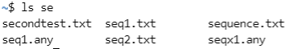
Tab completion
To speed up typing, LINUX has many tricks. Two are:
Short command names (ls, rm, cp)
Tab completion
"Tab" ("tabulation") is this key on your keyboard
Let's see it in action
$ echo "shock" > first_reaction.txt
To visualize long file names or directories, we can just use TAB to complete the sentence
$ cat fi <PRESS TAB>
$ ls fi <PRESS TAB>
If there are many possible hits, pressing TAB twice will show them all
$ ls s <PRESS TAB>

Slide 66
Commands Recap of Section 2 (Manipulating files)
Command | Description | Example
> | Redirect output to filename | $ echo foo > foo.txt
>> | Append output to filename | $ echo bar >> foo.txt
cat <file> | Print contents of file to screen | $ cat hello.txt
diff <f1> <f2> | Diff files 1 & 2 | $ diff foo.txt bar.txt
ls | List directory or file | $ ls hello.txt
ls -l | List long form | $ ls -l hello.txt
ls -rtl | Long by reverse modification time | $ ls -rtl
ls -a | List all (including hidden) | $ ls -a
touch <file> | Create an empty file | $ touch foo
mv <old> <new> | Rename (move) from old to new | $ mv foo bar
cp <old> <new> | Copy old to new | $ cp foo bar
rm <file> | Remove (delete) file | $ rm foo

Slide 67
Exercises
Use the echo command and the redirect operator > to make a file called foo.txt containing the text “hello, world”. Then, using the cp command, make a copy of foo.txt called bar.txt. Using the diff command, confirm that the contents of both files are the same.
By combining the cat command and the redirect operator >, create a copy of foo.txt called baz.txt without using the cp command.
Create a file called quux.txt containing the contents of foo.txt followed by the contents of bar.txt. Hint: Remember: cat can take multiple arguments.
Like rm, mv is dangerous and it can overwrite a file without warning. Take a last look at our first_reaction.txt file with cat and then overwrite it by moving testfile.txt onto it.

Slide 68
Exercises (more)
Type the sequence of commands needed to create an empty file called foo, rename it to bar, and copy it to baz.
What is the command to list only the files starting with the letter “g”? Hint: Use a wildcard.
Remove both bar and baz using a single call to rm. Hint: If those are the only two files in the current directory that start with the letter “b”, you can use the wildcard pattern from the previous exercise.

Slide 69
Exercises (continued)
Using echo, create a file title.txt containing this text:
Careful, “>” is a special character
>Title
Using echo, create a file sequence.txt containing this text:
GATGAPGIAGAPGFPGARGAPGPQGPSGAPGPK
Using cat, create a file file.fasta merging those two files
Then, rename it to dinosaur.fasta using mv
Check these files’ size with ls
Try the “human-readable” option
Using the online BLAST, look for the closest matches to this FASTA:
Extinct
Still alive

Slide 70
3. Inspecting files

Slide 71

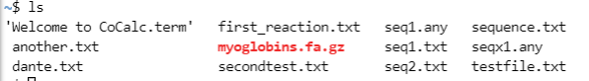
Downloading a file
On non-tutorial LINUX systems, downloading a file is easy. E.g.
$ curl –OL https://www.dropbox.com/s/uv1pe88x0wq3qfk/myoglobins.fa.gz
The command wget is usually faster and present in more systems:
$ wget https://www.dropbox.com/s/uv1pe88x0wq3qfk/myoglobins.fa.gz
On your COCALC tutorial environment, you must upload a file manually
First, download the file from https://www.dropbox.com/s/uv1pe88x0wq3qfk/myoglobins.fa.gz$dl=1
Then, upload it on COCALC (click till you make it)
If you succeed, you will see it when doing ls:

Slide 72
Exercises
Uploading the file myoglobins.fa.gz on your online LINUX is already a task
Why is it red when visualized by ls?
Using ls, confirm that myoglobins.fa.gz exists on your system. How big is it in bytes? Hint: Recall the “long form” option of ls.
The byte count in myoglobins.fa.gz is high enough that it’s more naturally thought of in kilobytes (often treated as 1000 bytes, but actually equal to 2¹⁰=1024 bytes). By adding the option -h (“human-readable”) to ls, list the long form of the myoglobins.fa.gz file with a human-readable byte count. How big is it?

Slide 73
Gzipped files
Zipping a file is fairly common to save disk space
Often, LINUX files are zipped by the command gzip
The file you downloaded is gzipped. Let's try to visualize its contents:
$ cat myoglobins.fa.gz

Slide 74
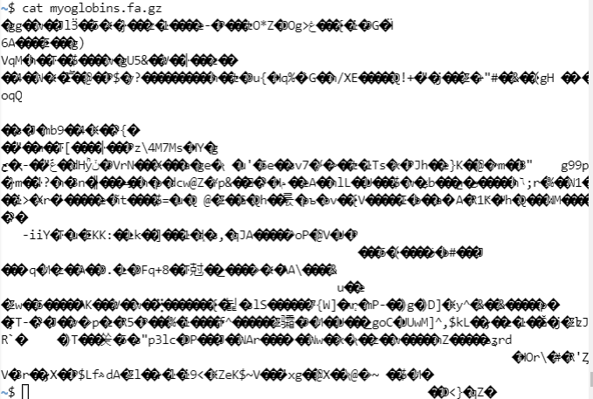

Gzipped files
Zipping a file is fairly common to save disk space
Often, LINUX files are zipped by the command gzip
The file you downloaded is gzipped. Let's try to visualize its contents:
$ cat myoglobins.fa.gz
Madness!

Slide 75

Gzipped files
On many systems (e.g., Windows), 7ZIP is a good program to unzip gz files
In LINUX, we can visualize the content before unzipping with zcat:
$ zcat myoglobins.fa.gz
You can type my <TAB> and it will be automagically completed
You can also just unzip the file, to save space
Unlike Windows, unzipping in LINUX doesn't keep the gzipped file
$ ls
$ gunzip myoglobins.fa.gz
$ ls
$ cat myoglobins.fa

Slide 76
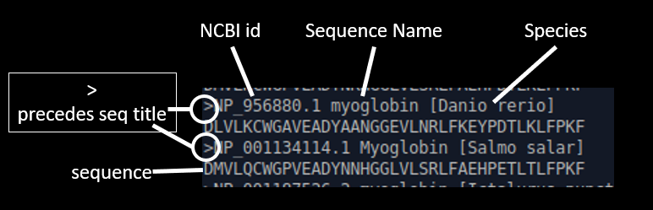
The FASTA format
$ cat myoglobins.fa
As you know, this is the FASTA format, very frequent in Bioinformatics
Common extensions: .fa .fas .fasta .fna .pep
It contains one or more sequences
Sequences can be DNA, RNA, Protein, or anything else (but not mixed types)
Each sequence is preceded by a title, always starting with the > ("greater than") symbol

Slide 77
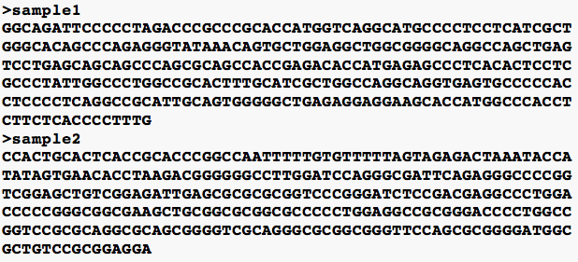
The FASTA format
In the myoglobins.fa.gz the sequences are small
Usually, sequences go to a new line every 60 or so characters (there is no standard)
The only rule is that each new sequence will have a title line starting with the > symbol

Slide 78
Head and tail
Useful when analyzing HUGE files without loading all of them
The head command by default shows the first 10 lines of the file
$ head myoglobins.fa
>AGM75745.1 myoglobin, partial [Mammuthus primigenius]
MGLSDGEWELVLKTWGKVEADIPGHGLEVFVRLFTGHPETLEKFDKFKHLKTEGEMKASE
>XP_003419836.1 myoglobin [Loxodonta africana]
MGLSDGEWELVLKTWGKVEADIPGHGLEVFVRLFTGHPETLEKFDKFKHLKTEGEMKASE
>NP_776306.1 myoglobin [Bos taurus]
MGLSDGEWQLVLNAWGKVEADVAGHGQEVLIRLFTGHPETLEKFDKFKHLKTEAEMKASE
>NP_001273527.1 myoglobin [Pantholops hodgsonii]
MGLSDGEWQLVLNAWGKVEADVAGHGQEVLIRLFTGHPETLEKFDKFKHLKTEAEMKASE
>NP_005359.1 myoglobin [Homo sapiens]
MGLSDGEWQLVLNVWGKVEADIPGHGQEVLIRLFKGHPETLEKFDKFKHLKSEDEMKASE
Use TAB: it helps you!
The tail command shows the last 10 lines:
$ tail myoglobins.fa
>XP_020029521.1 myoglobin [Castor canadensis]
MGLSDGEWQLVLKVWGKVEADLAGHGQEVLIRLFKGHPETLEKFDKFKHLKSEDEMKASE
>XP_004743506.1 PREDICTED: myoglobin [Mustela putorius furo]
MGLSDGEWQLVLNVWGKVEADLAGHGQAVLIR
>XP_026887314.1 myoglobin isoform X1 [Electrophorus electricus]
DLILKCWPPVEADYTGYGGAVLGRLFVEHPDTIKF
>NP_564181.1 Low affinity potassium transport system protein [Arabidopsis thaliana]
SEMGLSDEEWE
>NP_001241758.1 dopamine beta-monooxygenase precursor [Zea mays]
KIQADIPAHRGLGVFVLF

Slide 79
Wordcount
The command wc ("wordcount") gives an overview on a file, printing its size as a number of:
Lines
Words
Bytes
$ wc myoglobins.fa
66 181 3346
Our file has 66 lines, 181 words, and 3346 bytes (~ characters)
Let's reverse-engineer how many lines head prints by default
$ head myoglobins.fa > header.fa
$ wc header.fa
10 26 530

Slide 80

Piping
Creating an intermediate file to check a program occupies disk memory unnecessarily, it is dirty
We can overcome this with pipes
Pipes are a UNIX invention to redirect output as the input of the next command. The are implemented by the pipe symbol |
Same result, but faster, more elegant, and without intermediate files:
$ head myoglobins.fa | wc
10 26 530
So, LINUX has three directions for output:
On screen (STDOUT)
To files (> and >> redirect symbols)
To other programs (| symbol)

Slide 81
Exercises
By piping the results of tail myoglobins.fa through wc, confirm that (like head) the tail command outputs 10 lines by default
By running man head, learn how to look at the first n lines of the file. By experimenting with different values of n, find a head command to print out just enough lines to display the first entry (title + sequence)
Is the FASTA file myoglobins.fa containing protein or nucleotide sequences?
(HARD) Using a combination of head, pipe and tail, print only the sequence of the first FASTA entry (no title)
in other words: print only line 2

Slide 82
Scrolling files with more or less
You can visualize an entire file, page by page, using two nearly identical LINUX commands more and less :
$ more myoglobins.fa
$ less myoglobins.fa
Like in man pages, you can move inside this with
Arrow keys
Space bar
Page up / Page down keys
To get out, you can press q (quit)

Slide 83
Interlude, BLAST on Linux

Slide 84
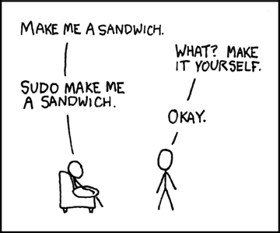
BLAST on Linux
Usually available (e.g. on CoCALC)
If not, it can be installed easily, but each Linux has a different way
You need administrative privileges
e.g. on Ubuntu and Debian:
$ sudo apt install ncbi-blast+
"Super User do": the command to give administrator power to the following commands

Slide 85
Easiest: BLAST on CoCalc
Open CoCalc
Check if BLAST is installed, try e.g. the BLAST program for nucleotides
$ blastn
BLAST query/options error: Either a BLAST database or subject sequence(s) must be specified
Please refer to the BLAST+ user manual.
If you get this error, it means BLASTN is correctly installed!

Slide 86

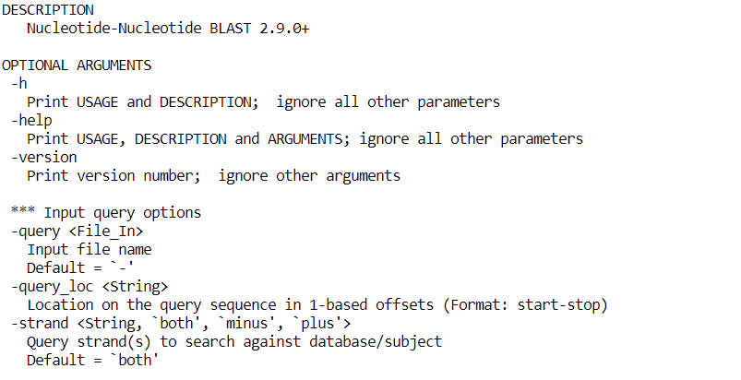
The manual of command-line BLAST
$ man blastn
No manual entry for blastn
$ blastn -help

Slide 87

Upload two files on CoCalc
FASTA
Input file: mystery sequence
https://www.dropbox.com/s/hr7ljfjdocrpxcj/input.fasta?dl=1
Database file: the annotated sequences to compare it with
https://www.dropbox.com/s/e9ffnke7ldzm8df/database.fasta?dl=1
Download them
Upload on CoCalc
Files...
Upload....

Slide 88
In a perfect world, this would be the query command...
$ blastn -query input.fasta -db database.fasta

Slide 89
...but we don't live in a perfect world
$ blastn -query input.fasta -db database.fasta
BLAST Database error: No alias or index file found for nucleotide database [database.fasta] in search path [/home/user::]

Slide 90
We need to format the database first!
Transform database.fasta into an indexed file
faster search
you do it only once for each database
I said only once!
You can query a MILLION TIMES, but you index only once
Command to index a database for BLAST:
This creates three extra files:
database.fasta.nin database.fasta.nhr database.fasta.nsq
$ makeblastdb -in database.fasta -dbtype nucl
$ ls

Slide 91
We are now ready to BLAST!
Let's run it!
$ blastn -query input.fasta -db database.fasta
Huge output!
You can either redirect to a file...
$ blastn -query input.fasta -db database.fasta > output.txt
Or you can redirect the output to less, to visualize it nicely
$ blastn -query input.fasta -db database.fasta | less

Slide 92
Exercises
Read the guide blastn -help
Print the output of the blast command as HTML
Redirect the HTML output to a file, e.g. > output.html
Download/open the HTML file
You can then play with changing formats e.g. -outfmt 6
Try parameters like -evalue -gapopen -penalty etc. Try all!

Slide 93
3. Inspecting files, part 2

Slide 94
Scrolling files with more or less
You can visualize an entire file, page by page, using two nearly identical LINUX commands more and less :
$ more myoglobins.fa
$ less myoglobins.fa
Like in man pages, you can move inside this with
Arrow keys
Space bar
Page up / Page down keys
To get out, you can press q (quit)

Slide 95
Searching patterns in less
Very powerful: forward slash key / puts you in search mode
Look for Rat sequences in myoglobins.fa using less:
Inside less, type /Rat <ENTER>
If you panic: CTRL-C + q
This is case sensitive. What happens if you search for /rat ?
To make the search case-insensitive, you can run less with –I option
$ less –I myoglobins.fa
And then look for /rat
You can navigate between matches using n (next) or shift-n (previous)
With the HOME/END keys you can move at the beginning/end of the file
Pro-tip: always use head and less to understand what a file contains

Slide 96
Recap of less commands
Command | Description | Example
up & down arrow keys | Move up or down one line
spacebar | Move forward one page
CTRL-F or Page Down | Move forward one page
CTRL-B or Page Up | Move back one page
END | Move to end of file
HOME | Move to beginning of file
/<string> + <ENTER> | Search file for string | /sapiens
n | Move to next search result
shift-n | Move to previous search result
P | Move to the first search result
q | Quit less (as in man)

Slide 97
Exercises
Run less on myoglobins.fa Try with a sequence match, like the polypeptide VLNVWG, subpart of the myoglobin protein. In how many species do you find it? Hint: scroll through the hits using n
Compare your results from the exercise before with the command:
$ grep VLNVWG myoglobins.fa
Can you think of a command to count the number of proteins with this motif?
Because man uses less, we are now in a position to search man pages interactively. By searching for the string “sort” in the man page for ls, discover the option to sort files by size. What is the command to display the long form of files sorted so the largest files appear at the bottom?
Since in our FASTA file we have small sequences occupying a single line, how many different species are there in the myoglobins.fa file? Find the answer by using wc

Slide 98


Exercises (continued, optional)
(HARD) Download the Human genome from NCBI (or ENSEMBL)
Version GRCh38
FASTA format
Overview: https://www.ncbi.nlm.nih.gov/genome/guide/human/
Actual link: http://ftp.ncbi.nlm.nih.gov/refseq/H_sapiens/annotation/GRCh38_latest/refseq_identifiers/GRCh38_latest_genomic.fna.gz
Upload it on COCALC (takes many many minutes)
No need to gunzip it! less is so smart, but more is stupid
The Human Genome and less
Space bar to go to the next page
/pattern <ENTER> to search
/chr
/ACGTTA
q to quit
$ zcat GRCh38_latest_genomic.fna.gz | grep ">NC"

Slide 99
Grep
grep ("global regular expression print") is a powerful command to search for text patterns in files and data
We can use it to search only for ">" lines in a FASTA file
$ grep ">" myoglobins.fa
Careful! > is also the redirect symbol in LINUX, so if you don't use quotes you will delete the myoglobins.fa file
If you do it, you have to redownload it, upload on COCALC, and gunzip it
This FASTA uses NCBI database nomenclature. The sequence IDs have some meaning:
NP_: Reference Protein, experimentally validated
XP_: Reference Protein, predicted
Anything else: not considered the representative sequence, due to lack of manual curation or evidence.

Slide 100
Grepping and Piping
We can of course redirect the output of grep to other commands:
$ grep ">" myoglobins.fa | head -n5
$ grep ">" myoglobins.fa | wc
We can use the –l option of wc to count only lines (faster for bigger files)
$ grep ">" myoglobins.fa | wc -l

Slide 101
Grepping the Human Genome
If you managed to put the Human Genome in the COCALC session, you can answer this question:
How many chromosomes do we have?
$ ls -alh GRCh38_latest_genomic.fna.gz
$ gunzip GRCh38_latest_genomic.fna.gz
$ ls -alh GRCh38_latest_genomic.fna
$ grep ">" GRCh38_latest_genomic.fna
$ grep ">NC" GRCh38_latest_genomic.fna | wc -l

Slide 102
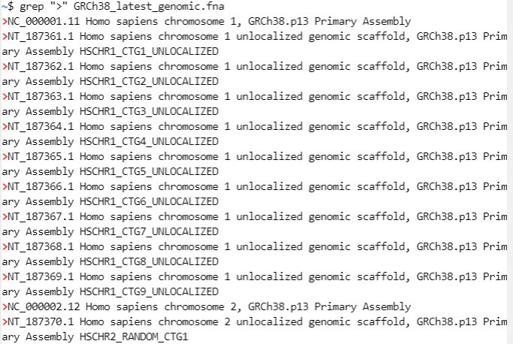
Grepping the Human Genome
$ grep ">" GRCh38_latest_genomic.fna

Slide 103
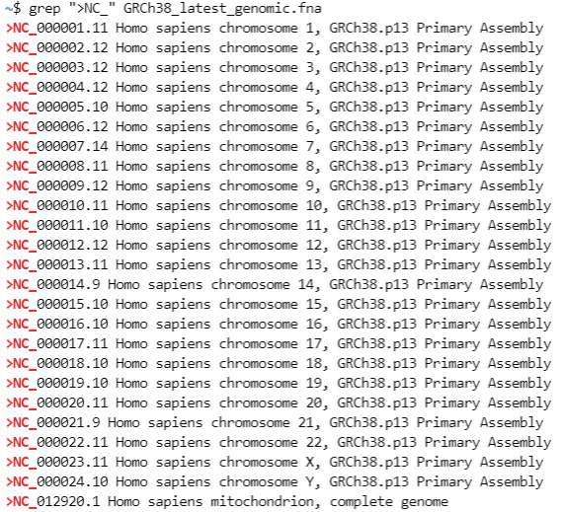
Grepping the Human Genome
$ grep ">NC_" GRCh38_latest_genomic.fna

Slide 104
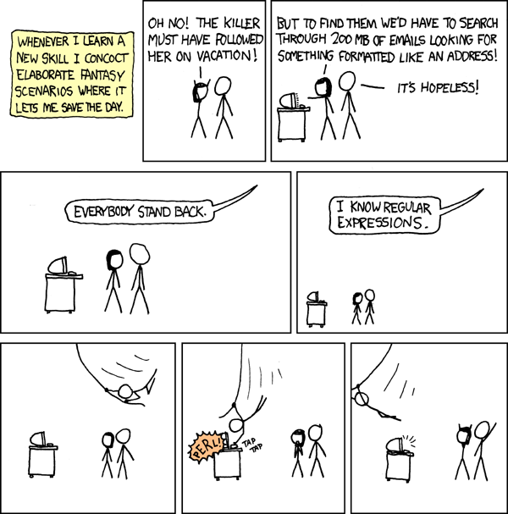
Regular Expressions
xkcd, issue 208

Slide 105
Regular Expressions
"Regex" for short
grep means "global regular expression print"
Regex: Vocabulary System for advanced text pattern matching

Slide 106
Regular Expressions - Simple Uses
Find all sequences containing Aspartic Acid (D)
$ grep "D" myoglobins.fa
Find all lines starting with Aspartic Acid (^ means "beginning of the line" in the regex World):
$ grep "^D" myoglobins.fa
Find all lines ending with Phenylalanine ($):
$ grep "F$" myoglobins.fa
Find all sequences having a Trypthophan (W) followed by any amino acid and preceding a Tyrosine (Y):
$ grep "W[A-Z]*Y" myoglobins.fa
This will match sequences like WGPMEADY and WGSMEANY

Slide 107
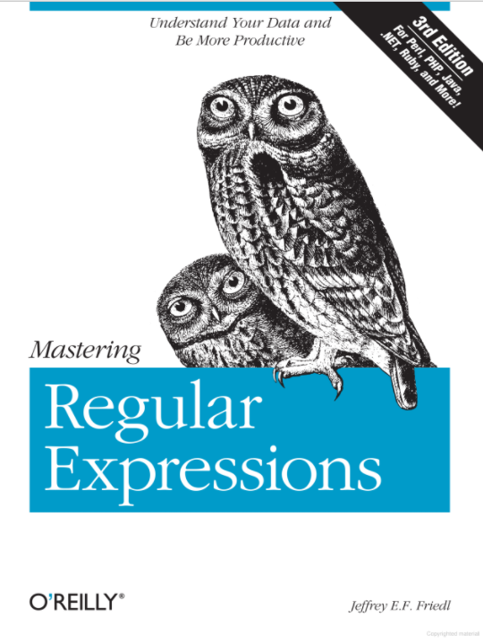
Book on Regular Expressions

Slide 108
Commands Recap of Section 3 (Inspecting files)
Command | Description | Example
curl | Interact with URLs | $ curl -O example.com $ curl -OL file.to.download.com
wget | Like curl -OL | $ wget file.to.download.com
which | Locate a program on the path | $ which curl
sudo apt install | Install a program | $ sudo apt install curl
head <file> | Display first part of file | $ head foo
tail <file> | Display last part of file | $ tail bar
wc <file> | Count lines, words, bytes | $ wc foo
cmd1 | cmd2 | Pipe cmd1 to cmd2 | $ head foo | wc
ping <url> | Ping a server URL | $ ping google.com
less <file> | View file contents interactively | $ less foo
grep <pattern> <file> | Find pattern in file | $ grep foo bar.txt
grep -i <pattern> <file> | Find case-insensitively | $ grep -i foo bar.txt
ps | Show processes | $ ps aux
top/htop | Show processes (sorted) | $ htop
kill -<level> <pid> | Kill a process | $ kill -9 24601

Slide 109
Exercises 1 of 4
By searching man grep for “matching lines”, construct a command to find the line numbers in myoglobins.fa where we have experimentally validated proteins. The output should be identical to a combination of grep, pipe and wc -l
At this point, you can read man pages better than anyone. Find the option in man grep that does an invert on the match and look for all sequences in myoglobins.fa that don’t have a Methionine (M).
And then, using pipe, grep out sequences that don’t have a ">" header
Using the -n option of grep, check which line numbers don’t have a ">" header in myoglobins.fa

Slide 110
Exercises 2 of 4 (HARD)
If you managed to upload the GRCh38_latest_genomic.fna
Print all FASTA titles from the file
Lots of them. You can pipe the output of grep into less!
Can you count the chromosomes using grep and wc?

Slide 111

Exercises 3 of 4 (HARD)
Of course, grep will work on any text file, not only FASTA
Download the human gene annotation file (GFF3 format) from GENCODE
https://www.gencodegenes.org/human/
http://ftp.ebi.ac.uk/pub/databases/gencode/Gencode_human/release_37/gencode.v37.annotation.gff3.gz
Upload it on COCALC (not as big as the genome file!)
Gunzip it
Can you...
Visualize the size of the file in 1) bytes and 2) line numbers
Try to visualize it with cat, fail miserably, get out of it with panic button
Visualize it with a UNIX program more suited for big files
This GFF3 file has very long lines! Very confusing. But less has a -S option that can help
(HARD) Try to guess on which chromosome is located the human Myoglobin gene. This is hard because you need to know the gene symbol and look for a specific string format you can grep. Hint: https://www.genecards.org/

Slide 112
Exercises 4 of 4
The history command prints the history of commands in a particular terminal shell (subject to some limit, which is typically large). Pipe history to less to examine your command history. What was your 17th command?
By piping the output of history to wc, count how many commands you’ve executed so far.
One use of history is to grep your commands to find useful ones you’ve used before, with each command preceded by the corresponding number in the command history. By piping the output of history to grep, determine the number for the last occurrence of curl.
!! (two exclamation marks) executes the previous command. Similarly, !n executes command number n, so that, e.g., !17 executes the 17th command in the command history. Use the result from the previous exercise to re-run the last occurrence of grep

Slide 113
4. Directories

Slide 114
Your place in the directory structure
/
“root”
bin
sbin
etc
tmp
lib
usr
home
user
Directory | Typical Contents
/ | The "root" directory
/bin | Essential system programs
/sbin | Superuser system utilities (for performing system administration tasks)
/etc | UNIX system configuration and information files
/tmp | Temporary file storage space (can be used by any user)
/lib | Program libraries (collections of system calls that can be included in programs by a compiler) for low-level system utilities
/usr | Higher level user programs
/home | User home directories containing personal file space for each user. Each directory is named after the login of the user.
/dev | Hardware devices
/media | Removable hardware devices
/proc | A pseudo-filesystem for each active program
Full path of present working directory:
$ pwd
Subdirectories of root directory:
$ ls /

Slide 115
Making Directories
Let's create a directory where to dump all our txt files, command mkdir:
$ mkdir txtfiles
$ ls
Notice how directories get different colors in the ls output?
Let's move there all our files (the "/" is unnecessary, but it helps reminding us that me are moving files to a directory):
$ mv *.txt txtfiles/
Let's copy the myoglobins.fa file there instead (it's a text file, but with a FASTA extension):
$ cp myoglobins.fa txtfiles/

Slide 116
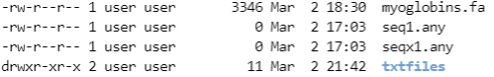
Showing the contents of a directory
We use ls to visualize the contents of a directory
$ ls txtfiles/
We use ls -d to visualize only if a directory exists
$ ls -d txtfiles/
We can combine -d with -l options
$ ls -dl txtfiles/
Notice the output of ls -l
$ ls -l

Slide 117


Finally, we can Change Directory with cd
$ cd txtfiles/
TAB is your friend!

Slide 118

Navigating Directories
Navigating directories is the hardest for Bioinformatics newbies
Always remember, if you are lost:
pwd will tell you in which directory you are
ls will tell you the contents of the current directory
cd by itself will bring you back to your home directory
$ cd
$ pwd
/home/user

Slide 119
Navigating Directories - more tricks
cd can be used to change directory using
Absolute path
Relative path
$ cd /var/log
$ cd /var
$ cd log
You can use the two-dots .. to go up one level
$ cd /opt/google/chrome
$ cd ..
$ pwd
/opt/google

Slide 120
Finding files in directories
Using the command find and option -name
Usage: find WHERE -name PATTERN
To find all FASTA files in our home directory:
$ find /home/user -name '*.fa'
/home/user/header.fa
/home/user/myoglobins.fa
/home/user/txtfiles/myoglobins.fa
While ".." means up one level, "." means this directory
It can be used to make find shorter (if you look for files in the current dir)
$ cd
$ find . -name '*.fa'

Slide 121
Exercises
Try to create the directory /home/user/good/morning with mkdir
What is the option for making intermediate directories as required, so that you can create, e.g. /home/user/good/morning with a single command (i.e. without creating /home/user/good first)?
Hint: Refer to the man page for mkdir
Use the option from the previous exercise to make the directory /home/user/bad/morning with a single command
By piping the output of ls to grep, list everything that contains the letter “o” in the txtfiles directory you created before.
Hint: if you are already in the correct folder, ls is enough (i.e. without specifying ls /home/user/txtfiles)

Slide 122
Renaming Directories
Easy, we will just use mv, as for files
$ cd
$ mkdir wrong
$ mv wrong/ right/
$ cd wrong/
-bash: cd: wrong: No such file or directory
$ cd right/

Slide 123
Copying Directories
Less easy than for files. Let's try to clone the test directory into newtest
$ cd
$ mkdir test
$ cd test/
$ touch filea.txt fileb.txt filec.txt
$ cd
$ cp test newtest
cp: -r not specified; omitting directory 'test'
OK let's use cp -r then
$ cp -r test newtest
$ ll test
$ ll newtest

Slide 124

Deleting Directories
The rm won't work, here it is definitely more difficult than for files
This difficulty is by design: deleting entire directories can be catastrophic
$ cd
$ rm test/
rm: cannot remove 'test': Is a directory
OK let's try rmdir then, but it will work only on empty directories
$ rmdir test/
rmdir: failed to remove 'test': Directory not empty
This solution will usually work but it is dangerous:
$ rm -rf test/
Read about the -r and -f options of rm:
$ man rm
Spiderman understands how to use the power of rm -rf responsibly. Be like Spiderman

Slide 125
Grepping in Subdirectories
Sometimes we want to search for something in all directories, recursively
grep needs an extra option for that
Let's try to find the word Mammuthus in files located in subdirectories
$ cd
$ mkdir species
$ echo "Mammuthus primigenius" > species/file.txt
$ cp myoglobins.fa species/
$ grep "Mammuthus" species/
grep: .: Is a directory
We need the -r (recursive) option
$ grep -r "Mammuthus" species/

Slide 126

Another grep option
Imagine that you don't know if a word is capitalized
Was it "mammuthus" or "MAMMUTHUS" or "Mammuthus"?
You can force grep to be case-insensitive with the -i option
$ grep -ri "mAmMuThUs" species/
Spongebob needs the case-insensitive grep -i

Slide 127
Exercises
Make a directory foo with a subdirectory bar, then rename the subdirectory to baz
Copy all the files in txtfiles, with directory, into baz
Copy all the files in txtfiles, without directory, into bar
Remove foo and everything in it using a single command

Slide 128
Commands Recap of Section 4 (Directories)
Command | Description | Example
mkdir <name> | Make directory with name | $ mkdir foo
pwd | Print working directory | $ pwd
cd <dir> | Change to <dir> | $ cd foo/
cd ~/<dir> | cd relative to home | $ cd ~/foo/
cd | Change to home directory | $ cd
cd - | Change to previous directory | $ cd && pwd && cd -
. | The current directory | $ cp ~/foo.txt .
.. | One directory up | $ cd ..
../.. | Two directories up | $ cd ../..
find | Find files & directories | $ find . -name foo*.*
cp -r <old> <new> | Copy recursively | $ cp -r ~/foo .
rmdir <dir> | Remove (empty) dir | $ rmdir foo/
rm -rf <dir> | Remove dir & contents | $ rm -rf foo/
grep -ri <string> <dir> | Grep recursively (case-insensitive) | $ grep -ri foo bar/

Slide 129
5. UNIX Conclusions

Slide 130
Conclusions
You now know all the basic UNIX commands
Knowing UNIX/LINUX is one of the basic skills of a Bioinformatician
UNIX is the only operating system used in high performance computers and computer clusters
We will try to use some more advanced UNIX in the rest of the course to solve basic problems of Genomics

Slide 131
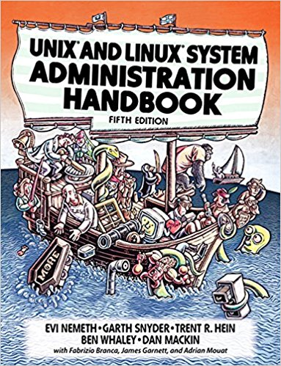

Essential Bibliography
Learning the bash Shell - Unix Shell Programming (3rd edition) by Cameron Newham
UNIX and Linux System Administration Handbook (5th Edition) by Evi Nemeth, Garth Snyder, Trent R. Hein, Ben Whaley, Dan Mackin

Slide 132
Federico M. Giorgi, PhD
Department of Pharmacy and Biotechnology
federico.giorgi@unibo.it

Slide 133

The Italian Academic System
Lab Technician
As I understood it, according to Gelmini 2010 law
BSc Student
RTD: Ricercatore a Tempo Determinato (Fixed term Researcher), type A or B
Postdoc
Max 6 years
MSc Student
RTDA
3 + 2 years
"Laureato Frequentatore"*
RTDB
3 years
PhD Student
National Scientific Habilitation (ASN) + Teaching/Research evaluation
3 years
Associate Professor
Unknown how (great merits?)
Contracts:
*Unpaid intern
Full Professor
Permanent
Fixed Term
Emeritus Professor

Slide 134
The Italian Academic System
Lab Technician
As I understood it, according to Gelmini 2010 law
BSc Student
RTD: Ricercatore a Tempo Determinato (Fixed term Researcher), type A or B
Postdoc
Max 6 years
MSc Student
RTDA
3 + 2 years
Abroad
(e.g., Montalcini program)
"Laureato Frequentatore"
RTDB
3 years
PhD Student
National Scientific Habilitation (ASN) + Teaching/Research evaluation
3 years
Associate Professor
Other Jobs
- Teaching
- Research
-Business
- Anything
Unknown how (great merits?)
Contracts:
Full Professor
Permanent
Fixed Term
Emeritus Professor

Slide 135


Slide 136
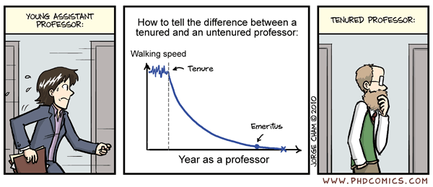
RTDA
Associate Professor
RTDB
Full Professor

Slide 137
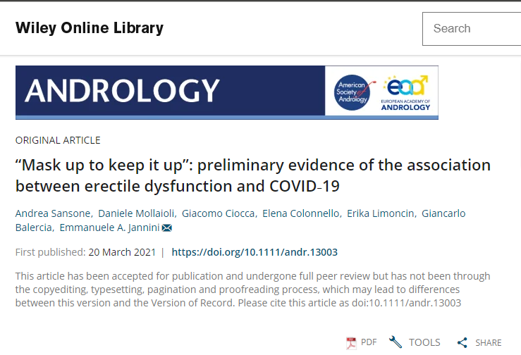
SARS-CoV-2 research corner
https://onlinelibrary.wiley.com/doi/10.1111/andr.13003

Slide 138
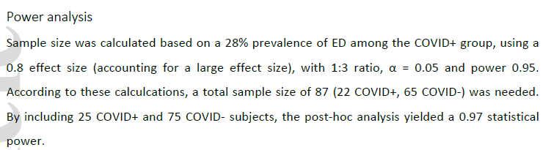
"Mask up to keep it up"
preliminary evidence of the association between erectile dysfunction and COVID-19
Design:
Web-based questionnaire
April 7th to May 4th 2020 in Italy
Measured:
Erectile Dysfunction (ED), BMI (body-mass index), psychological stress, age, etc.
985 sexually active men
25 with positive SARS-CoV-2 test
75 negative taken as control

Slide 139
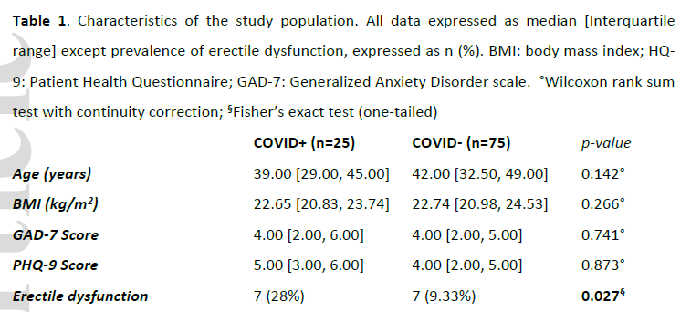
The dataset
BMI: Body Mass Index
GAD-7: Generalized Anxiety Disorder scale
PHQ-9: Patient Health Questionnaire

Slide 140
Statistical Analysis
Do positive males have more ED than negative males?
Model out confounding variables with logistic regression

Slide 141
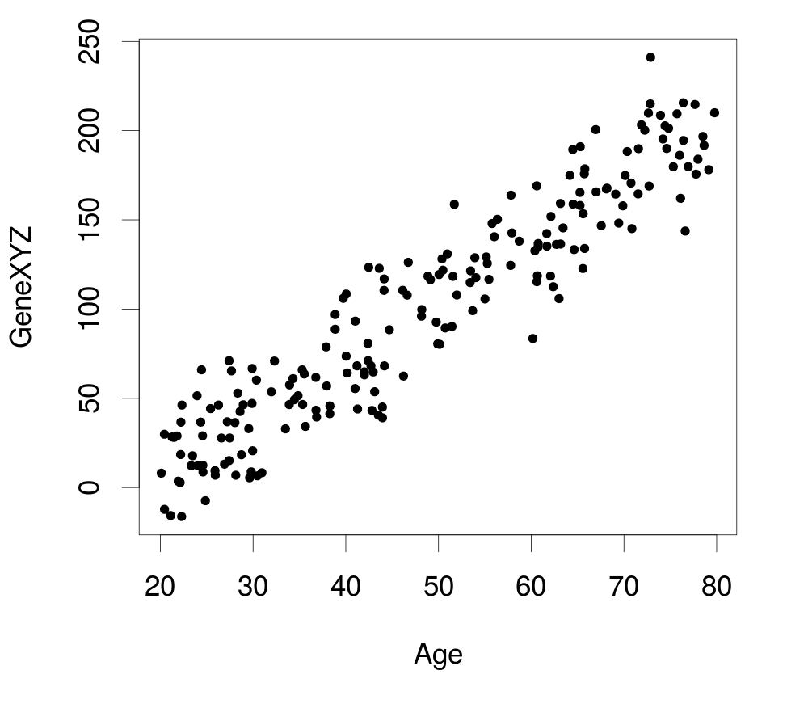
Modeling out a variable
Caveat: COVID-19 is not a continuous, but a categorical effect
COVID-19
GAD score

Slide 142
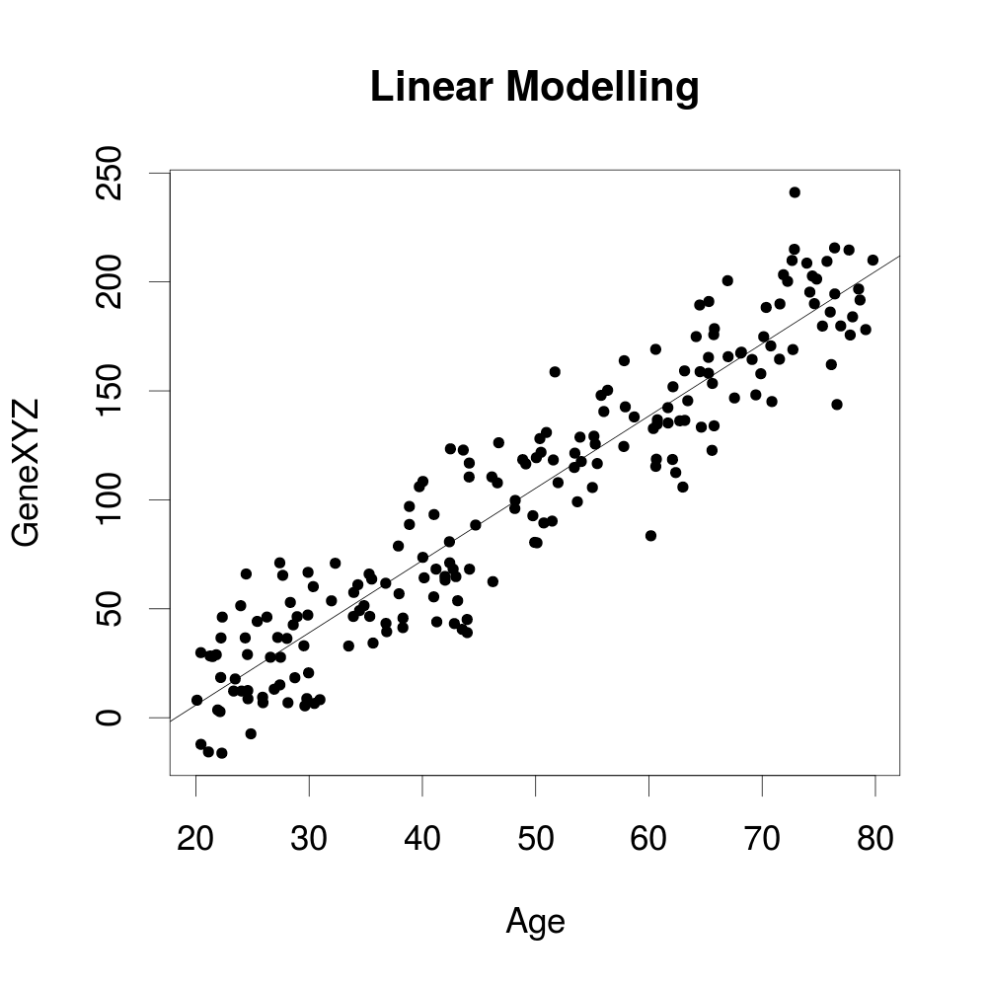
Modeling out a variable
COVID-19
GAD score

Slide 143
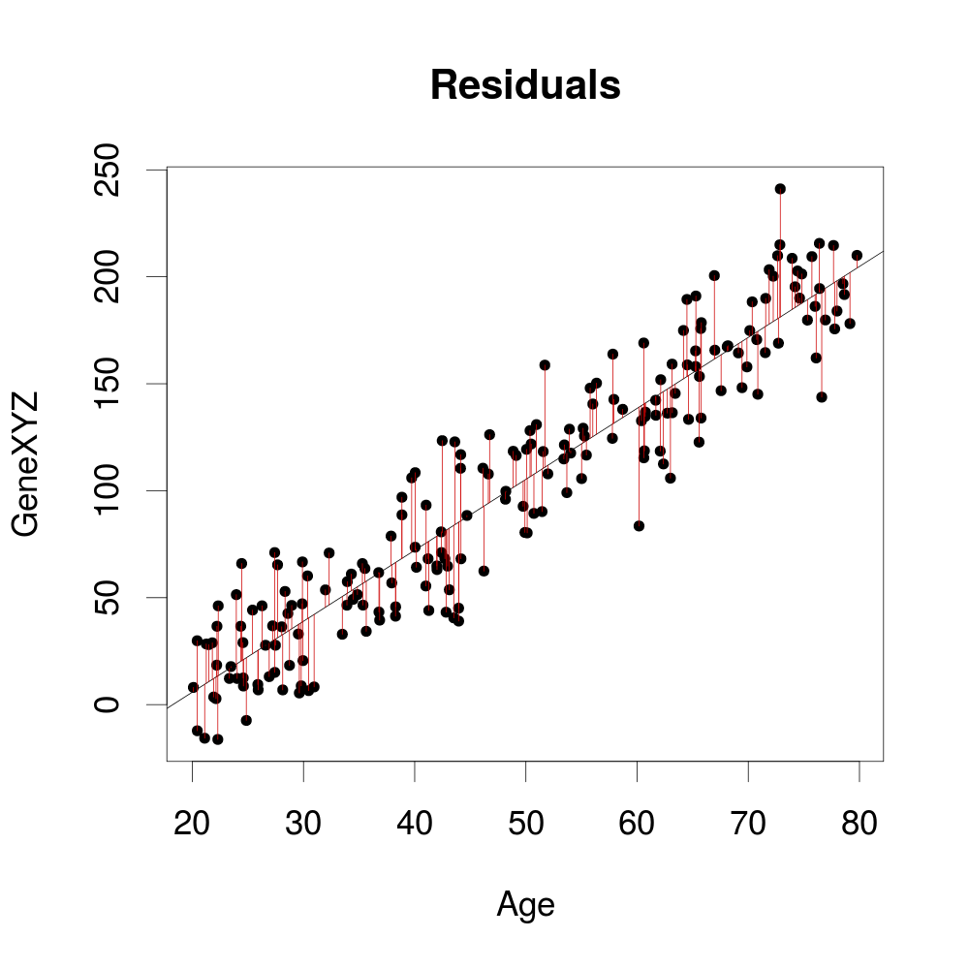
Modeling out a variable
COVID-19
GAD score

Slide 144
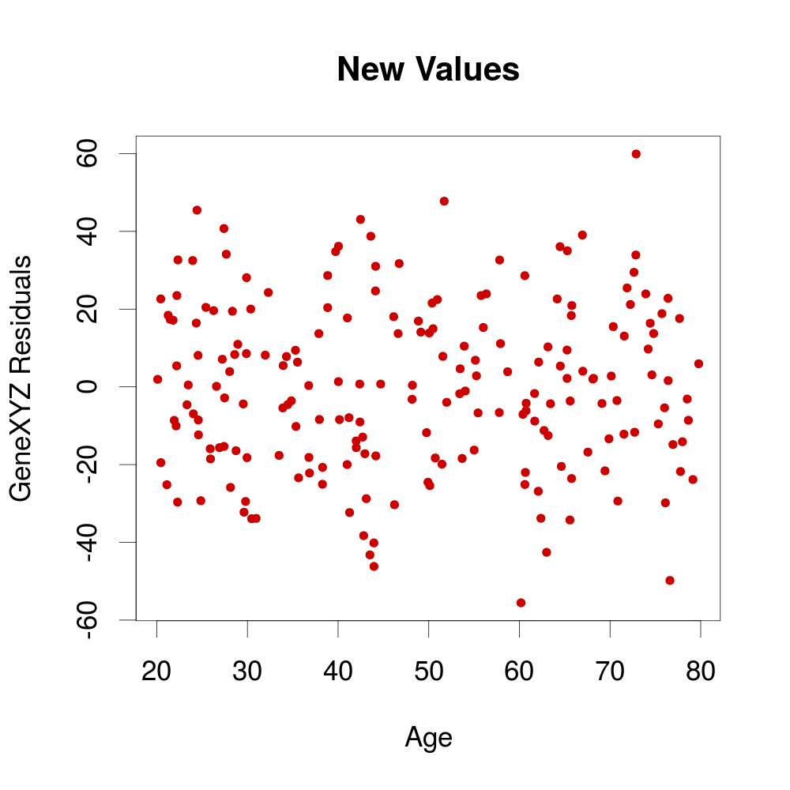
Modeling out a variable
COVID-19
GAD score

Slide 145
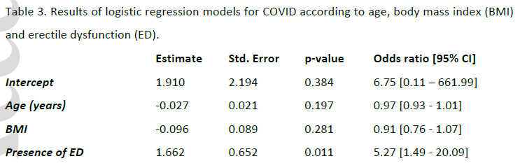
Statistical Analysis
Do COVID19 positive males have more ED than negative males?
Make a logistic regression
COVID-19 = intercept + aBMI + bED + cAge

Slide 146
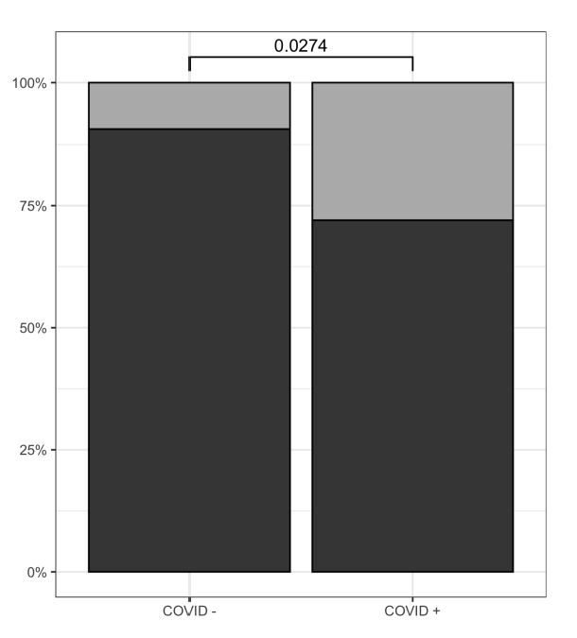
The only figure
Prevalence of ED in COVID+ vs COVID- groups
7/25 (28.0%) in COVID+
7/75 (9.3%) in COVID-
p-value = 0.0274
How was it calculated?
Percentage in group

Slide 147
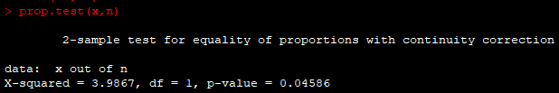
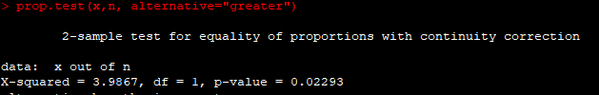
Re-calculating the p-value
7/25 ED (28.0%) in COVID+
7/75 ED (9.3%) in COVID-
p-value = 0.0274
R snippets (execute "R" in Cocalc):
?prop.test
x<-c(7,7)
n<-c(25,75)
prop.test(x,n)
prop.test(x,n, alternative="greater")

Slide 148



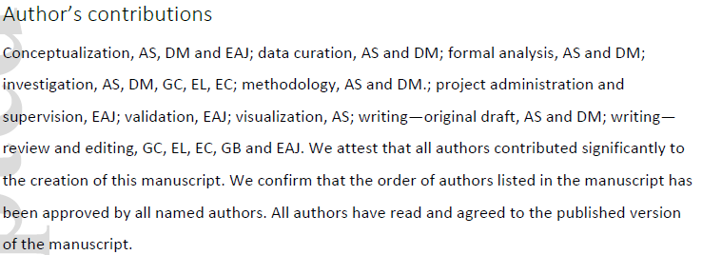
Extra info that usually goes into a paper

Slide 149
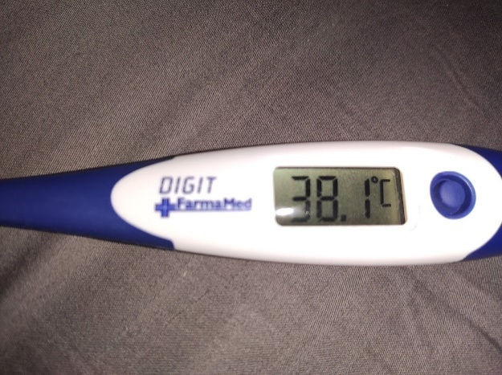





AZ Vaccine Side effects?
Mild fever
Fatigue
Chills
Craziness peak 5:00
Still rocking, 22:00
Genomics class 14:00
???
24:00
Uh-ho
23:00
Vaccine, 11:50
*timeline not on scale

Slide 150


The AstraZeneca Vaccine
https://www.nature.com/articles/d41586-021-00785-7?utm_source=twitter&utm_medium=social&utm_content=organic&utm_campaign=NGMT_USG_JC01_GL_Nature

Slide 151


What is the AZ vaccine’s role in the pandemic?
Easy to store (fridge)
Low Cost per dose
Approved in >100 countries
Distributed doses:
20M EU + UK
27M India
170M to mid-income countries

Slide 152


How effective is the vaccine?
22 March 2021: AZ declared 79% effectiveness at preventing COVID-19 in a trial of 32,449 adults
23 March 2021: NIAID (US National Institute of Allergy and Infectious Disease) expressed concerns on the previous estimate, based on "outdated information", expressing an efficacy of 69-74%

Slide 153

How safe is the vaccine?
< 10 cases of blood-clotting conditions that followed vaccines (mostly in women aged 55 or younger)

Slide 154


How does the AZ vaccine perform against variants?
Preliminary results in one UK trial show similar levels of protection against NC_045512.2 (original Wuhan strain) and B.1.1.7 "English" variant
2000 patients trial showed lower protection against the B.1.351 "South African" variant

Slide 155


The B.1.1.7 variant
Defining SNPs:
aa:orf1ab:T1001I aa:orf1ab:A1708D aa:orf1ab:I2230T del:11288:9 del:21765:6 del:21991:3 aa:S:N501Y aa:S:A570D aa:S:P681H aa:S:T716I aa:S:S982A aa:S:D1118H aa:Orf8:Q27* aa:Orf8:R52I aa:Orf8:Y73C aa:N:D3L aa:N:S235F
aa:S:D614G
https://cov-lineages.org/global_report_B.1.1.7.html

Slide 156


The B.1.351 variant
Defining SNPs:
aa:E:P71L
aa:N:T205I
aa:orf1a:K1655N
aa:S:D80A
aa:S:D215G
aa:S:K417N
aa:S:A701V
aa:S:N501Y
aa:S:E484K
aa:S:D614G
https://cov-lineages.org/global_report_B.1.351.html

Slide 157


The PANGO SARS-CoV-2 lineage nomenclature
https://www.nature.com/articles/s41564-020-0770-5

Slide 158

SARS-CoV-2 Mutation Tracker
https://outbreak.info/situation-reports

Slide 159
Exercise
Using the outbreak.info and cov-lineages.org resources, define everything you can about the mutation S:T478K (Spike Protein, aa 478)
Does it belong to a specific lineage/variant (i.e. collection of mutations)
Is it growing in frequency?
Is it located in the SARS-CoV-2 Spike / Human ACE2 interface?
In which countries does it appear?
Any further idea on how to predict its effect?
Any idea is good!

Slide 160


ACE2
N439K
N501Y
Human ACE2
SARS-CoV-2 Spike
S477N
https://www.tandfonline.com/doi/full/10.1080/07391102.2021.1886175

Slide 161

The ultimate chart to fix problems in Bioinformatics

Slide 162


